Slide 1
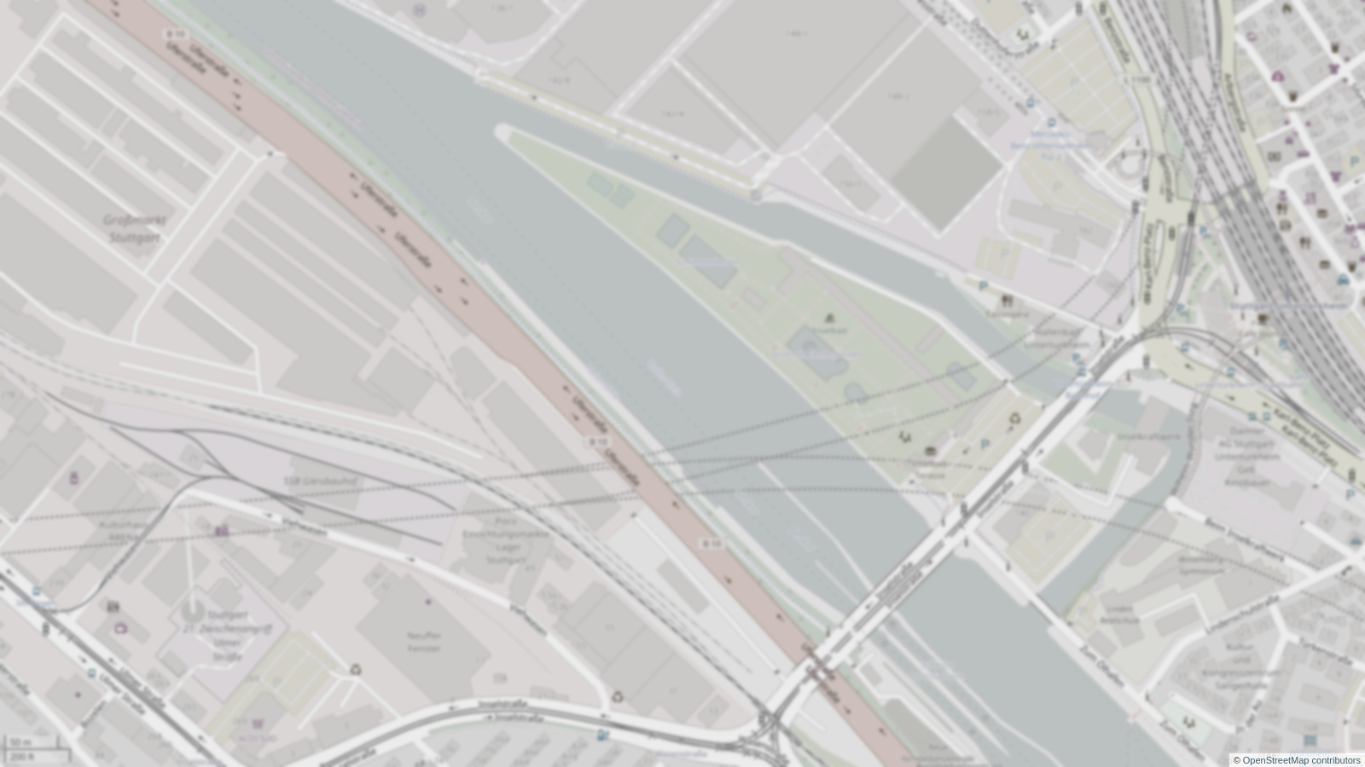
Tunnel-Gott-Erkenner
aka. Tunnel-God-Detector
Andreas H, Andreas M, Jonas, Michael, Stefan, Daniel, Blagica
NASA SpaceApps Challenge Stuttgart 2017
github.com/aerospaceresearch/tunnel-gott-erkenner
tunnelgott@aerospaceresearch.net

Slide 2
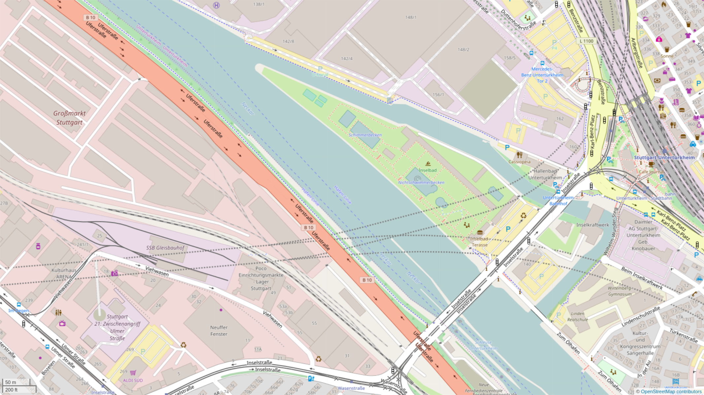
NASA SpaceApps Challenge Stuttgart 2017

Slide 3
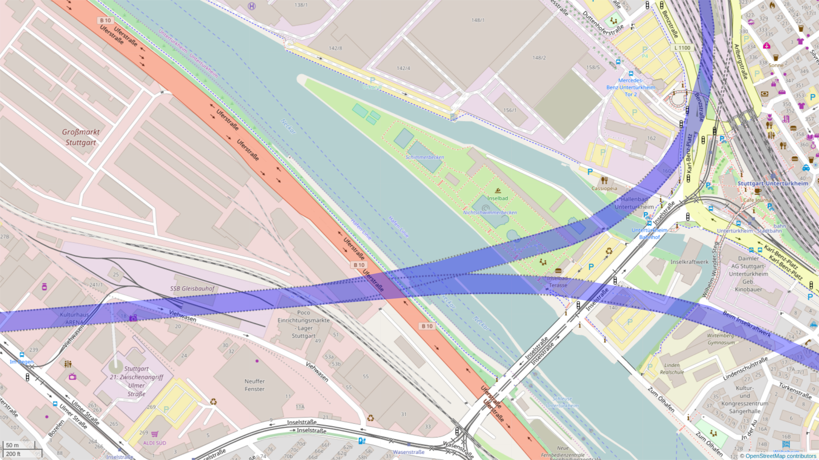
NASA SpaceApps Challenge Stuttgart 2017

Slide 4
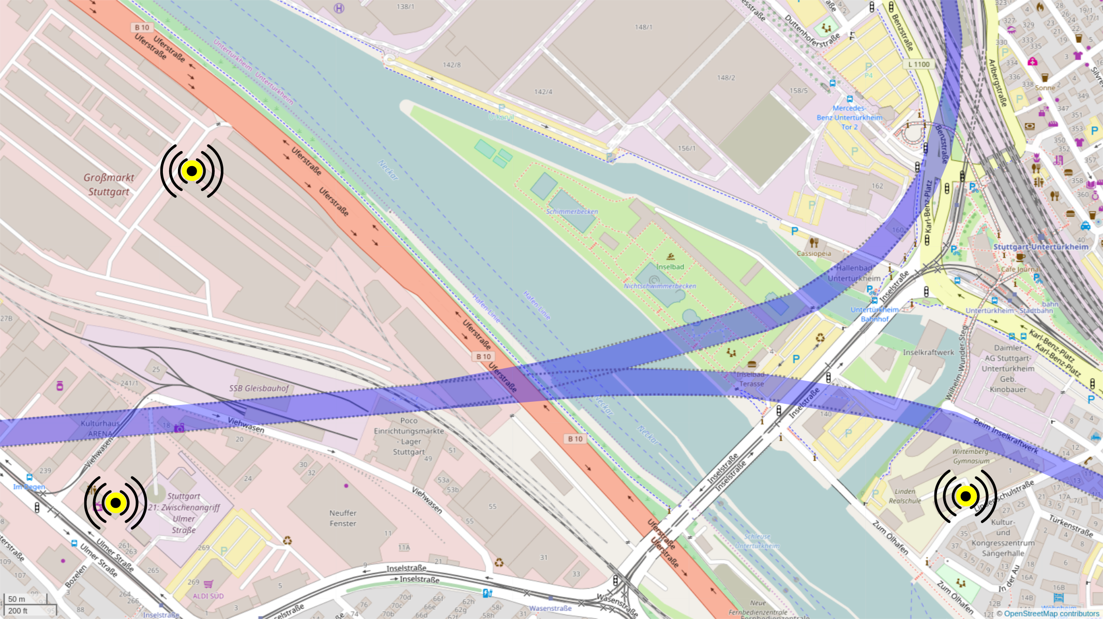
NASA SpaceApps Challenge Stuttgart 2017

Slide 5
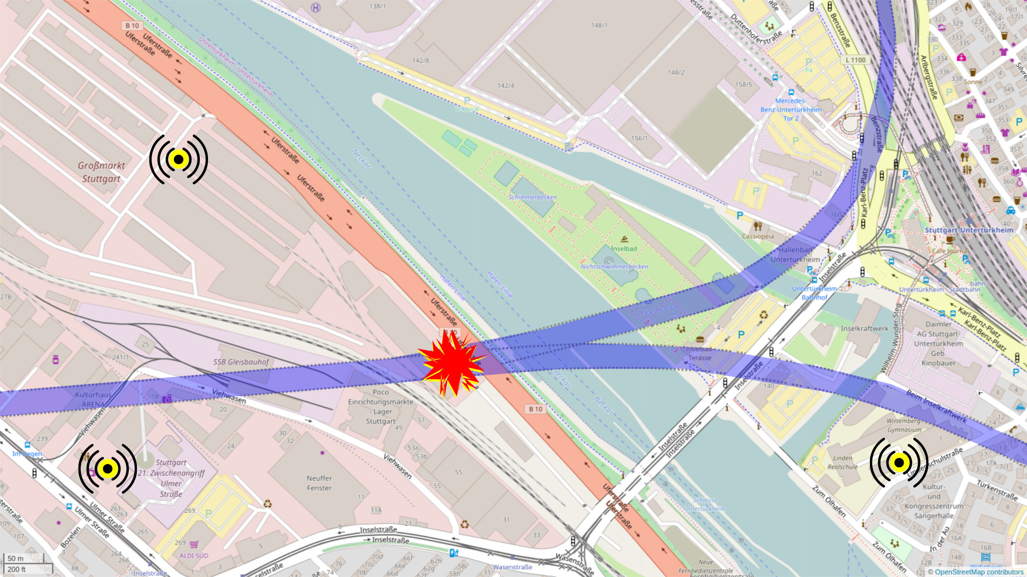
NASA SpaceApps Challenge Stuttgart 2017

Slide 6
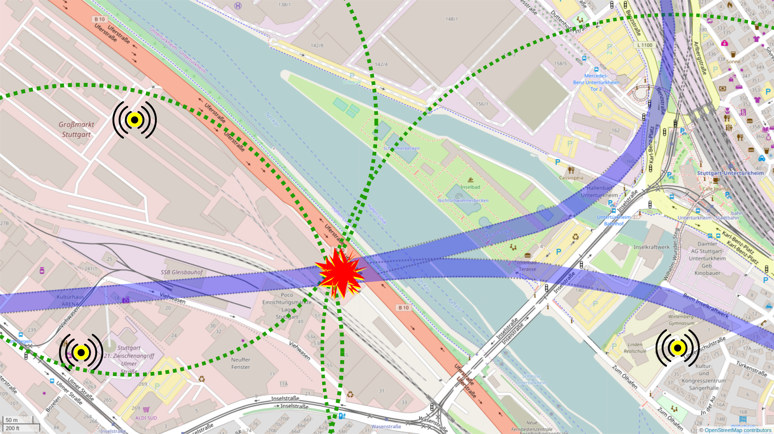
NASA SpaceApps Challenge Stuttgart 2017

Slide 7
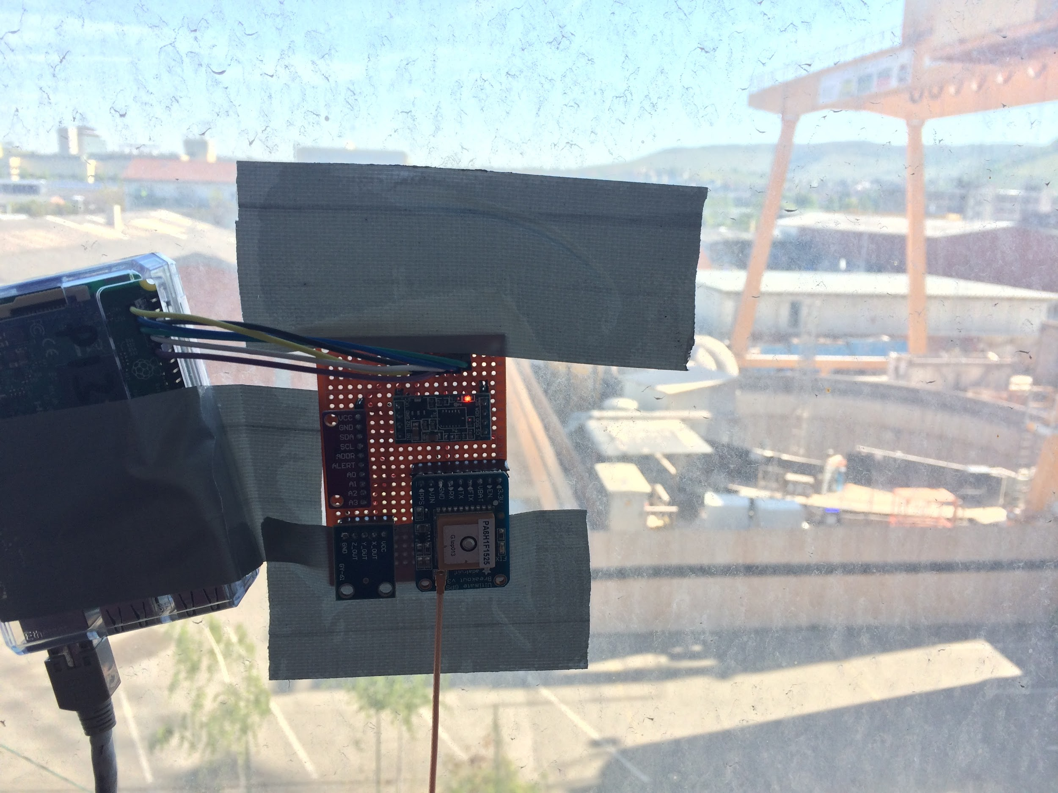
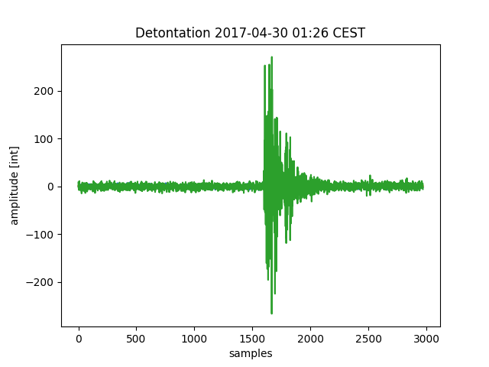

Tunnel Gott Detector #3
detected
detonation
now on github

